Slide 1


Predicting HDB Resale Prices
Leo Siu-Yin
Metis

Slide 2
03
Motivation
04
About The Project Project Goals
TABLE OF CONTENTS
06
Methodology
09
Results
11
Conclusion
12
Future Work
Project Stages
Tools Used
Data
Model Comparison
Assumptions Test

Slide 3

MOTIVATION
—Story of how Mencius’ mother moved three times to find the right place for Mencius’ upbringing.
孟母三迁

Slide 4
ABOUT THE PROJECT
ABOUT THE PROJECT
HDB Resale Flats have always been a hot commodity.
What are some important factors that affect HDB Resale Prices?
Families can decide better on their purchase of HDB Resale Flat.

Slide 5
PROJECT GOALS
Find out factors that affect prices of HDB Resale Flats.
Find most suitable model that fits existing data.
Predict HDB Resale Flat prices using the selected model.
Goal 1
Goal 2
Goal 3

Slide 6
PROJECT STAGES
PROJECT STAGES
Obtain data from data.gov.sg.
2000 most recent resale transactions.
Stage 1
Webscraping
Stage 2
Empty columns removed.
Flat types, Storey Range, Remaining Lease changed from object to numerical representation.
Removed highly correlated variables.
Log resale price to remove skew.
Data Cleaning
Exploratory Data Analysis
Converted categorical variables (town) to dummy variable representation.
Compared results between Linear Regression, RidgeCV Regression and LassoCV Regression.
Check test results of the final selected model. (RidgeCV regression model).
Stage 3
Model Building
Test Results

Slide 7








TOOLS USED
Tools Used

Slide 8
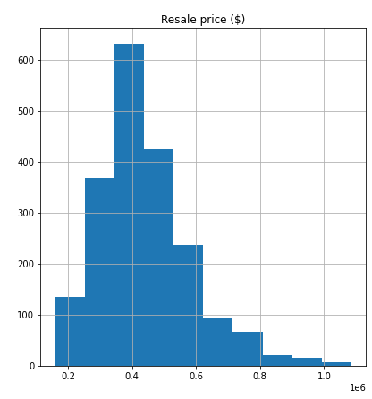
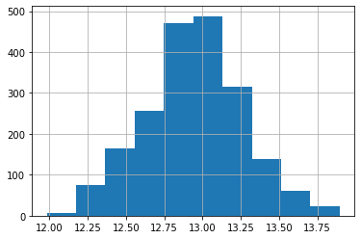
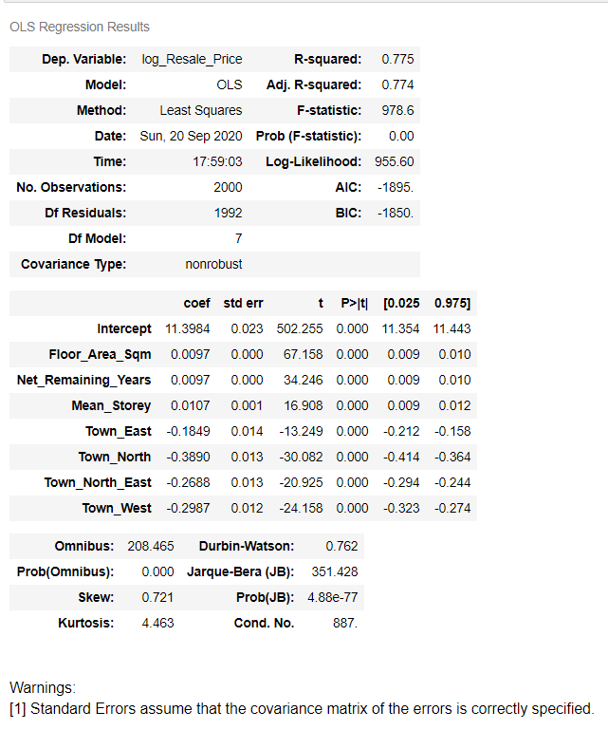
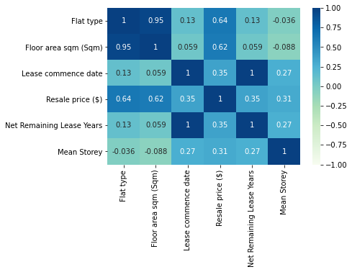
Data

Slide 9
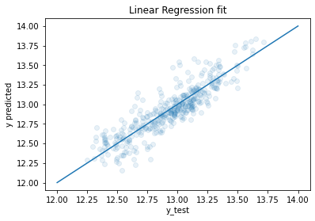
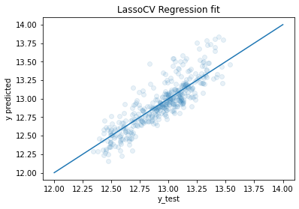
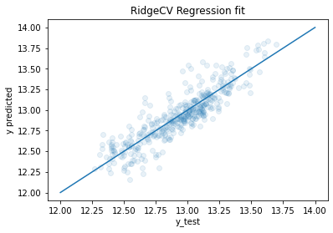
Model Comparison
Linear Regression | LassoCV Regression | RidgeCV Regression
MAE 0.115170 | MAE 0.121675 | MAE 0.114181
MSE 0.022781 | MSE 0.026426 | MSE 0.022711
Points of observed data are most symmetric around the line of predicted data from the RidgeCV Regression Model.

Slide 10
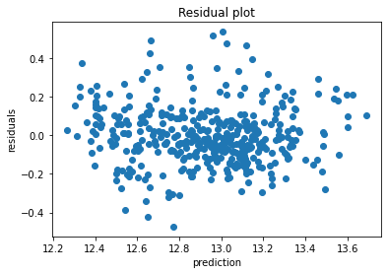
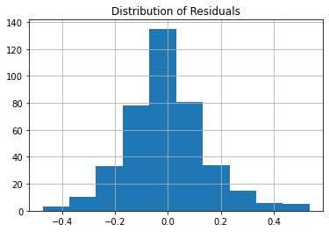
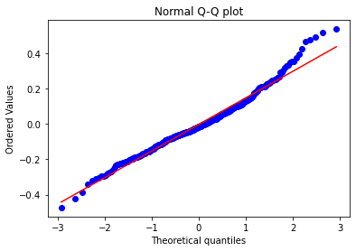
RidgeCV Model
Residuals are normally distributed around 0 (mean) - errors have a constant variance.
Randomness in residuals - model chosen makes little systematic errors.
Q-Q plot formed a relatively straight line - real data is not too skewed but some extremities exist.
Little or no concern on issues of multicollinearity based on selected independent variables.

Slide 11
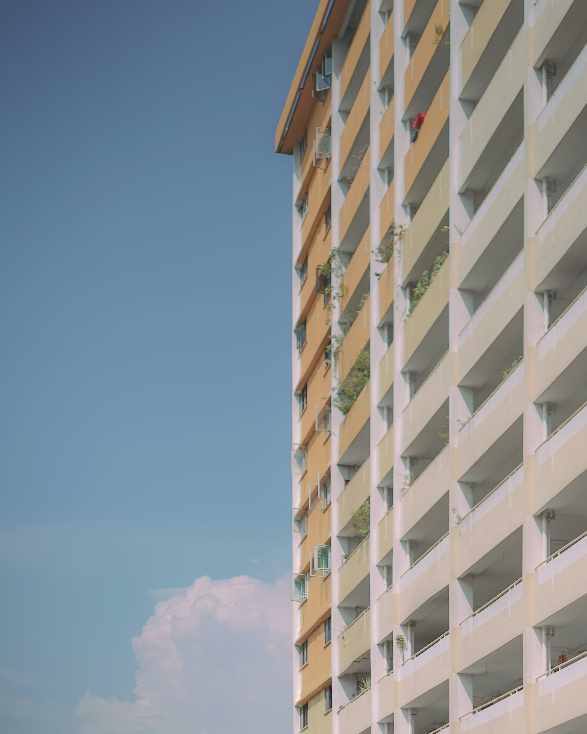

CONCLUSION
39,000
Difference between predicted and actual prices
1. Floor Area
1. Central
2. Remaining Lease
2. East
3. Storey of flat
3. North-East
4. West
5. North

Slide 12
FUTURE
Future Work
Availability of market, good schools, proximity of transport lines could be incorporated into the study of HDB Flats Resale prices.

Slide 13


THANK YOU
Follow Project Updates on
https://www.linkedin.com/in/syleo/
https://github.com/syleo22/SiuYin_Projects
syleo22@gmail.com

Slide 14
Appendix- Town Definition
APPENDIX
North
Sembawang
Woodlands
Yishun
North-East
Ang Mo Kio
Hougang
Punggol
Sengkang
Serangoon
West
Bukit Batok
Bukit Panjang
Choa Chu Kang
Clementi
Jurong East
Jurong West
Tengah
East
Bedok
Pasir Ris
Tampines
Central
Bishan
Bukit Merah
Bukit Timah
Central
Geylang
Kallang/ Whampoa
Marine Parade
Queenstown
Toa Payoh

